Slide 1
Python Sys Module – Important Functions

Slide 2
Python sys module
The python sys module provides functions and variables which are used to manipulate different parts of the Python Runtime Environment. It lets us access system-specific parameters and functions.
To Access Summarized information & Detailed Information- constants, functions, methods:
➔ import sys
print(dir(sys))
print(help(sys))
OutPut:
['__breakpointhook__', '__displayhook__', '__doc__', '__excepthook__', '__interactivehook__', '__loader__', '__name__', '__package__', '__spec__', '__stderr__', '__stdin__', '__stdout__', '__unraisablehook__', '_base_executable', '_clear_type_cache', '_current_frames', '_debugmallocstats', '_enablelegacywindowsfsencoding', '_framework', '_getframe', '_git', '_home', '_xoptions', 'addaudithook', 'api_version', 'argv', 'audit', 'base_exec_prefix', 'base_prefix', 'breakpointhook', 'builtin_module_names', 'byteorder', 'call_tracing', 'callstats', 'copyright‘ ..etc

Slide 3
>>> sys.version
'3.8.2 (tags/v3.8.2:7b3ab59, Feb 25 2020, 22:45:29) [MSC v.1916 32 bit (Intel)]‚
>>> sys.version_info
sys.version_info(major=3, minor=8, micro=2, releaselevel='final', serial=0)
Command-line Arguments in Python sys Module(sys.argv)
sys.argv is a list in Python, which contains the command-line arguments passed to the script.
If you are gonna work with command line arguments, you probably want to
use sys.argv.
To use sys.argv, you will first have to import the sys module.

Slide 4
Example
To show how this works.
(Remember that sys.argv[0] is the name of the script.
import sys
print("Hello {} Welcome to {} tutorial".format(sys.argv[1],sys.argv[2]))
OutPut:
Changing the Output Behavior of the Shell (sys.displayhook )
We’ve so often used the Python shell interactively and even as a calculator. But what if we wanted to change how it delivers the output? Well, we can; we simply rebind sys.displayhook to a callable object.

Slide 5
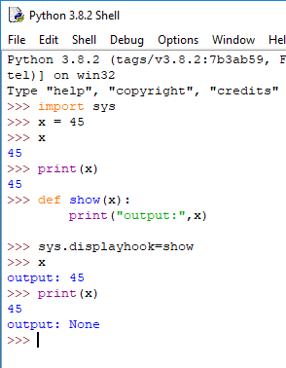
Example:

Slide 6


readline()
We can also use the readline() method to get input from the user:
The following piece of code lets us print to the screen(write),Also it displays number of character:

Slide 7
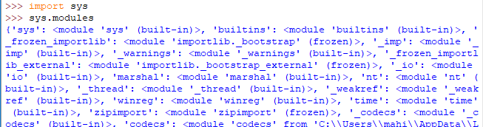
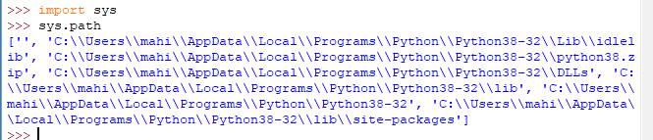
Getting Names of Modules:
sys.modules in Python gives us a dictionary of the names of the modules existing in the current shell.
Investigating the Path in Python sys Module:
sys.path in Python will give you a list of paths it will search in whenever you make an import.

Slide 8
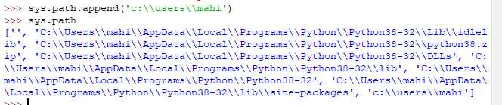

You can add a path to this with the append() method
Getting the Copyrights in Python sys Module:
sys.copyright in Python displays the copyright information on the currently-installed version of Python.

Slide 9


Exiting Current Flow of Execution in Python sys Module
sys.exit in Python lets the interpreter abruptly exit the current flow of execution.
Getting Reference Count and Platform
The getrefcount function gives us the count of references to an object where used. When in a program, this value drops to 0, Python cleans up the memory for this variable. Let’s take an example.

Slide 10


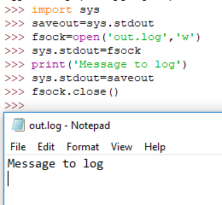
To get the name of the platform we’re running Python on, we make a call to sys.platform in Python:
Redirecting Output in Python sys Module
Instead of delivering the output to the console, you can log into a text file.

Slide 11
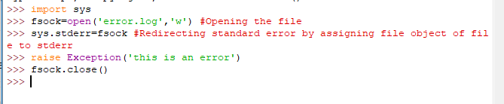
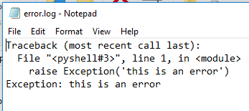
Redirecting Error Information in Python sys Module
Using sys.stderr and a text file in Python, we can log error information to the text file. See how:

Slide 12
Python Os Module

Slide 13

Python Os Module:
The Os Module in Python provides functions for interacting with the Operating system. Totally 63 modules are available lets see the common modules used.
OS. Name:
This function gives the name of the operating system. The following names are currently been registered “POSIX”
“Os2”,”ce”,”java”,”nt” and “riscos”
Code:

Slide 14
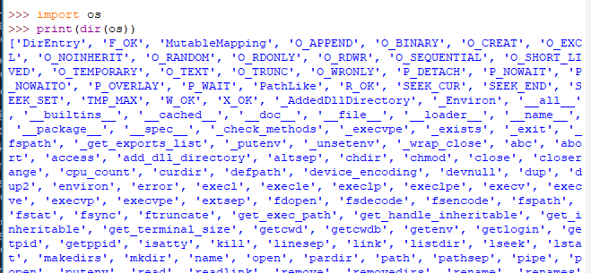
OS.dir():
It will list the all of attributes which we have access

Slide 15

Os.getcwd():
getcwd() Python os Module returns the current working directory of a process.
OS.Error:
It mainly tells me the error that we get in the os functions, Like When I am using OS.Name,OS.getcwd() etc. in any methods of OS module if it results in exceptions or error. Will get to see that through OS.Error.
And this is used implicitly by the Python interpreter

Slide 16
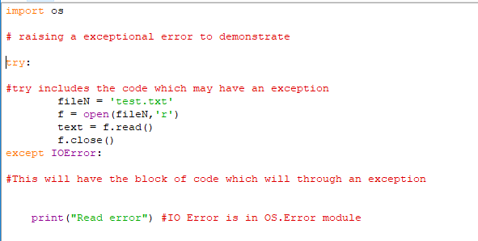
Example:

Slide 17
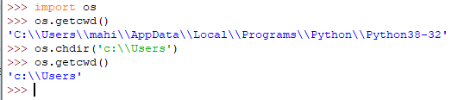

OS.Chdr()
Used to change directory
OS.listdir()
It will list the directory of folders

Slide 18
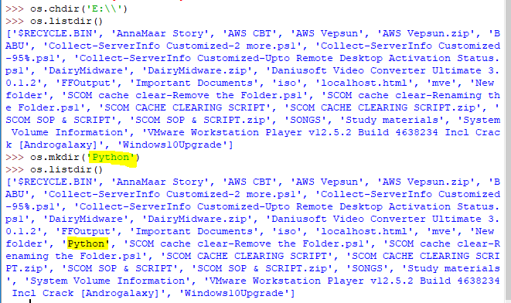

OS.MKDIR()
It will create the new directory
OS.Makedirs()
It will create directory with the subfolder

Slide 19
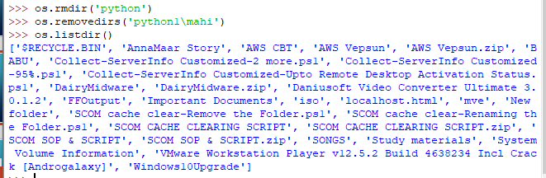
OS.rmdir() & OS.removedirs
Rmdir ➔ Will not delete entire directory
Removedirs ➔ Will delete directory with sub folders

Slide 20
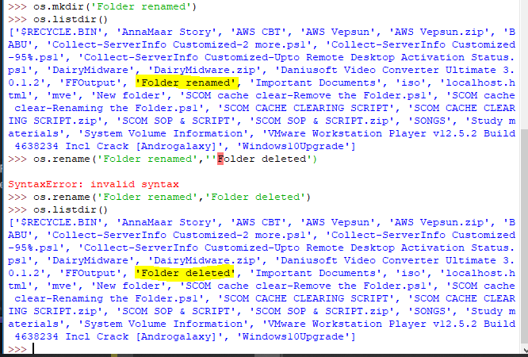
OS.Rename() ➔ used to rename the file or folder

Slide 21
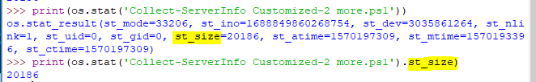

OS.stat() ➔ Used to identify the file or folder properties
OS.path.exists()
It is used to check the path is exists or not

Slide 22

Os.path.isdir() & os.path.isfile()
It will return true or false

Slide 23
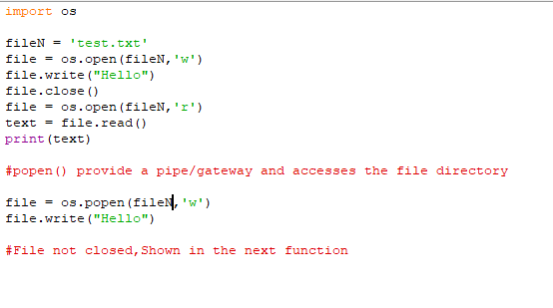
popen(command[, mode[, bufsize]])
This Python os Module popen() will open a pipe to, or from, the command specified .It returns an open file object that is connected to the pipe. We can read or write to this object depending on whether the mode is ‘r’ (default) or ‘w’. The bufsize argument means the same as in the open() function.

Slide 24
close(fd)
This Python os module closes the associated file with descriptor fd.
In Normal close function does not provide you the error when the file handling is happening(File Not available)
Os.close will throw an error, telling like we are following the proper flow or not
Ex:
Os.close(file)

Slide 25
References:
https://data-flair.training/blogs/python-os-module/
https://www.tutorialspoint.com/python/os_file_methods.htm
https://data-flair.training/blogs/python-sys-module/
Thank You

